Slide 1
NDPC MEMBERSHIP AWARDS
Recognizing Excellence in Safety, Community Engagement, and Environmental Stewardship

Slide 2
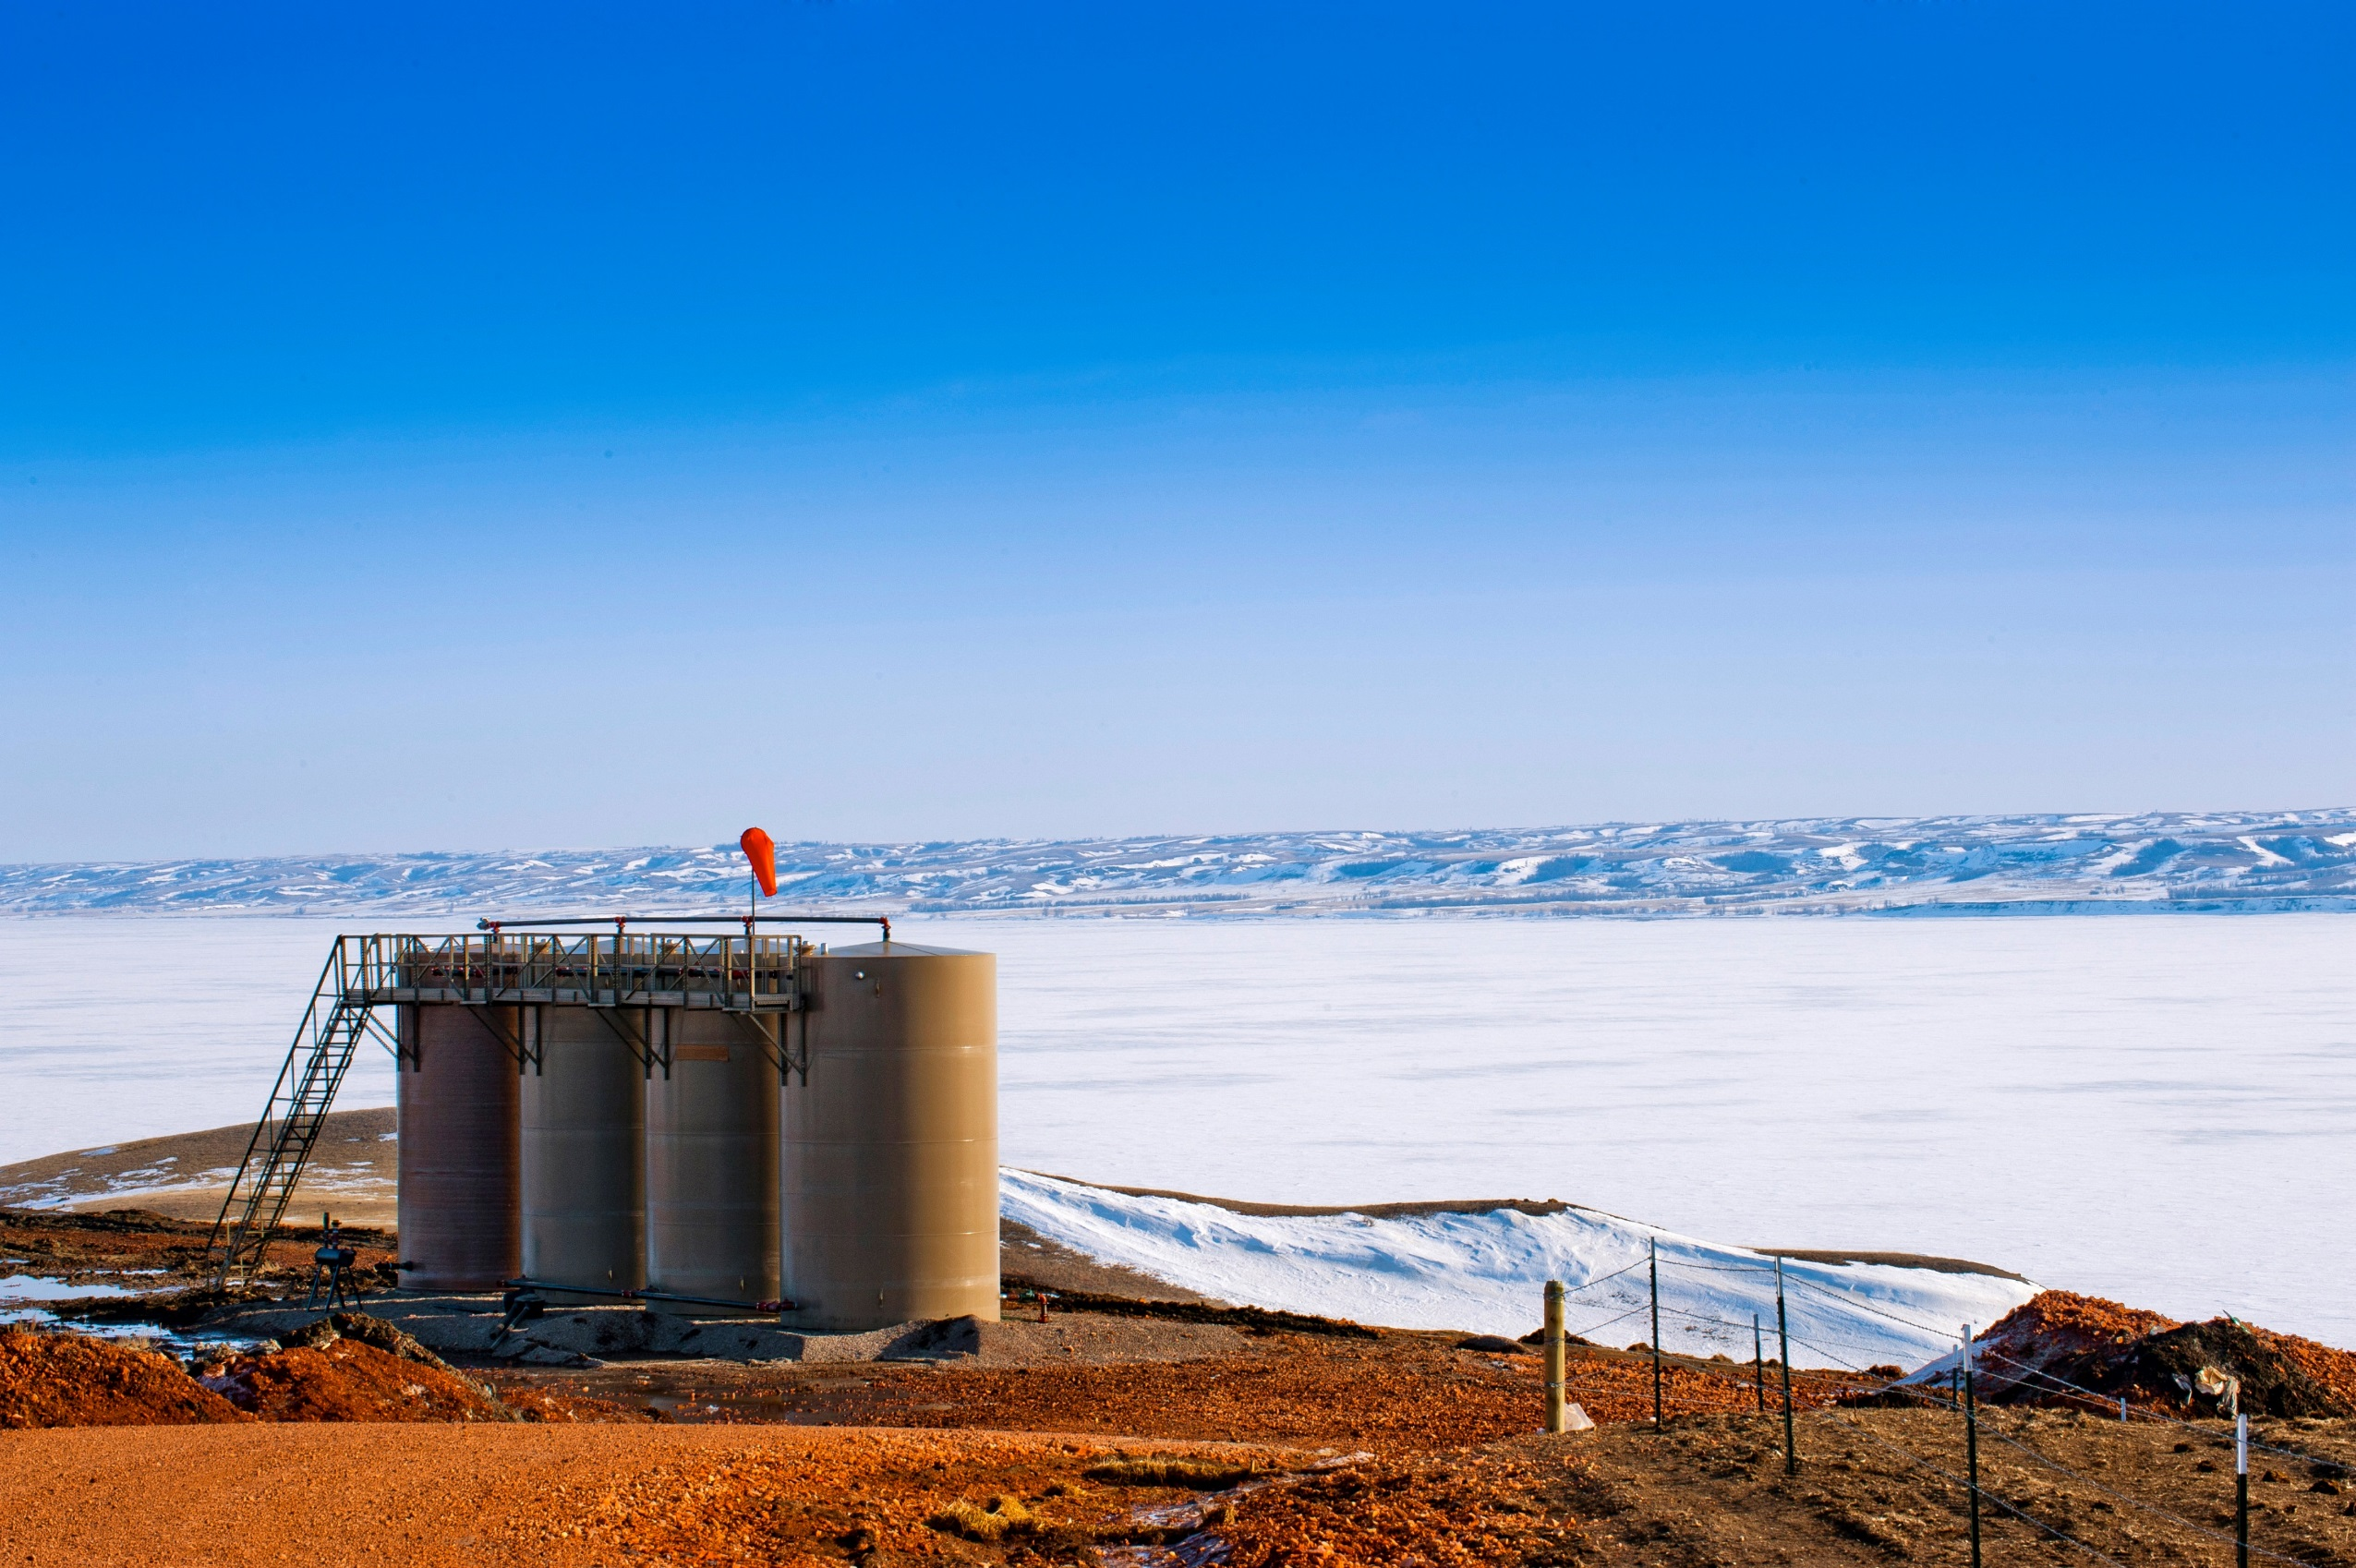
AWARD NOMINEES
THANK YOU TO ALL THE COMPANIES WHO SUBMITTED THEIR AWARDS!
SAFETY
CONTINENTAL RESOURCES
DELTA CONSTRUCTORS
ONEOK
SAULSBURY INDUSTRIES
WHITING PETROLEUM
COMMUNITY
CONOCOPHILLIPS
CONTINENTAL RESOURCES
CRESTWOOD
DELTA CONSTRUCTORS
ENERPLUS RESOURCES
HESS
NORTHERN STATES FISHING TOOLS
ONEOK
ENVIRONMENTAL
CONTINENTAL RESOURCES
CREEDENCE ENERGY SERVICES
CRUSOE ENERGY SYSTEMS
NODAK OILFIELD SERVICES
NUVERRA
OASIS

Slide 3
Excellence in
SAFETY
RECOGNIZES A COMPANY THAT HAS GONE ABOVE AND BEYOND TO CREATE A CULTURE OF SAFETY IN THE WORKPLACE.

Slide 4
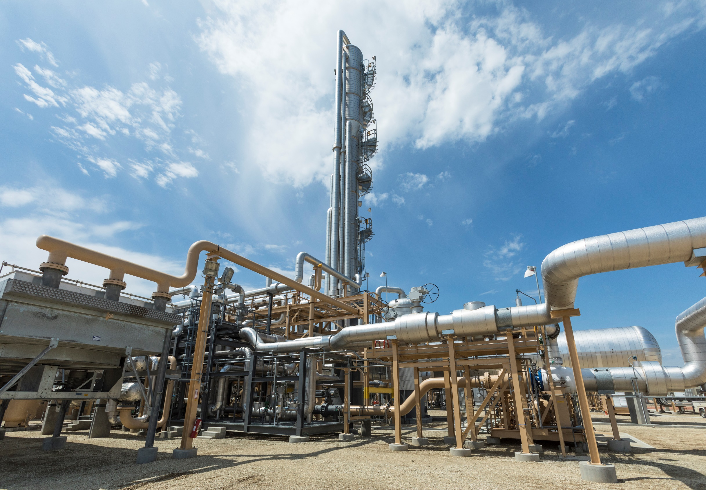

Excellence in
SAFETY
“BEHAVIORAL BASED SAFETY (BBS) PROGRAM”
AWARDED TO

Slide 5
Excellence in
COMMUNITY ENGAGEMENT
RECOGNIZES A COMPANY THAT EMBODIES THE SPIRIT OF COMMUNITY BY WORKING TO BUILD BETTER RELATIONS BETWEEN THE INDUSTRY AND COMMUNITY AND INSPIRE OTHERS TO DO THE SAME.

Slide 6
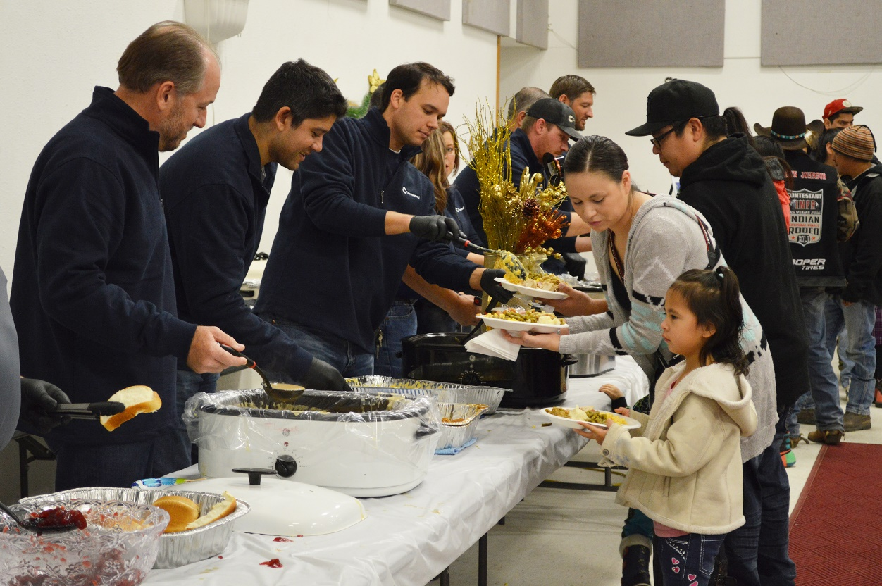

Excellence in
COMMUNITY ENGAGEMENT
“FUNDING THE FUTURE”

Slide 7
Excellence in
ENVIRONMENTAL STEWARDSHIP
RECOGNIZES A COMPANY THAT SHOWS COMMITMENT TO ENVIRONMENTAL STEWARDSHIP THROUGH THE DEPLOYMENT OF TECHNOLOGY, EFFORTS OR INITIATIVES THAT CONTRIBUTE TO A CLEANER ENVIRONMENT.

Slide 8
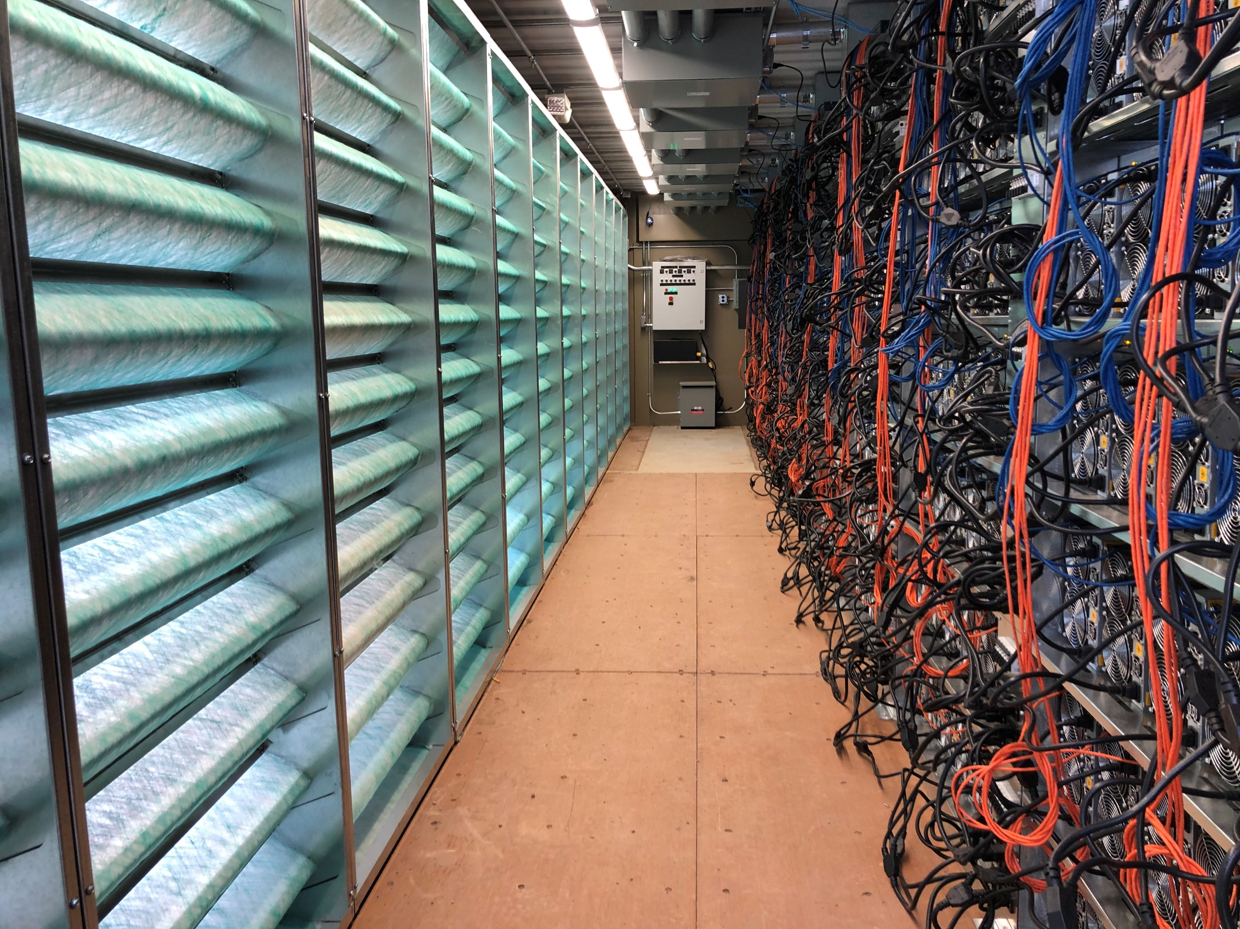

Excellence in
ENVIRONMENTAL STEWARDSHIP
“Digital Flare Mitigation® ”

Slide 9
DISTINGUISHED INDUSTRY LEADER

Slide 10
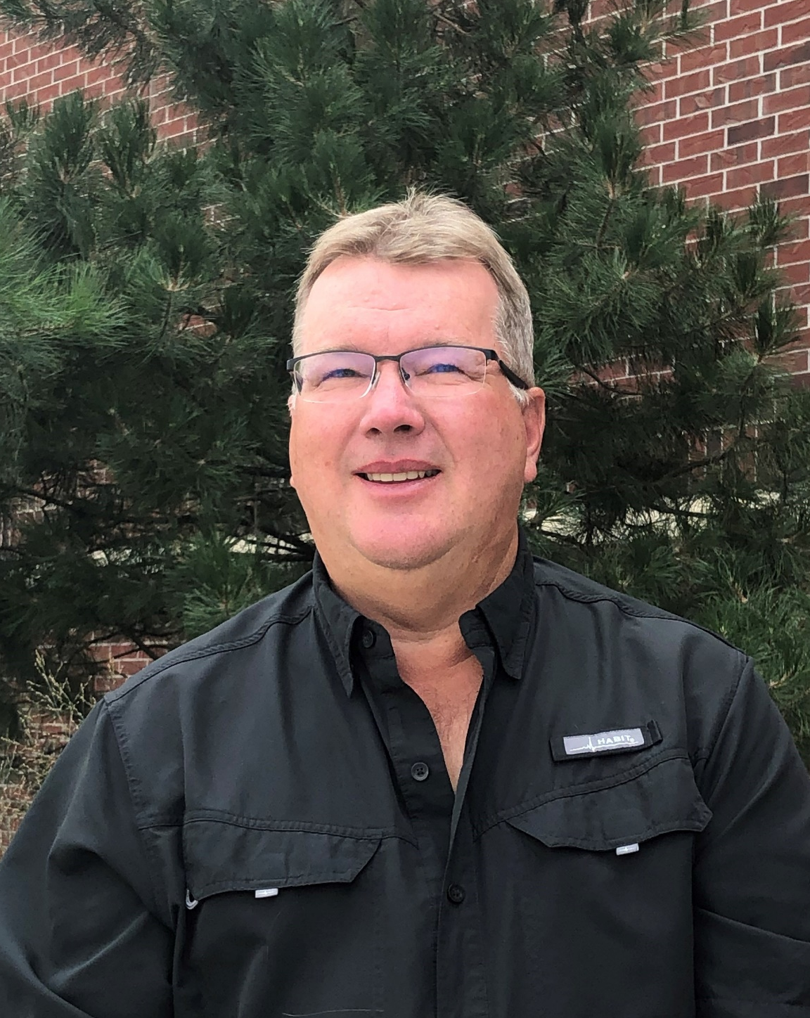
Distinguished
INDUSTRY LEADERS
Brian Grote
MONDAK REGIONAL MANAGER, BALON VALVES
Brian Grote
MONDAK REGIONAL MANAGER, BALON VALVES

Slide 11
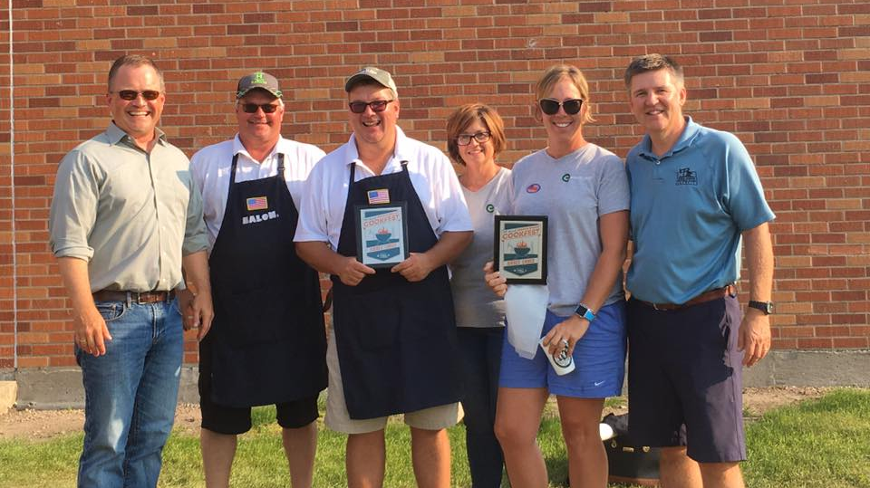
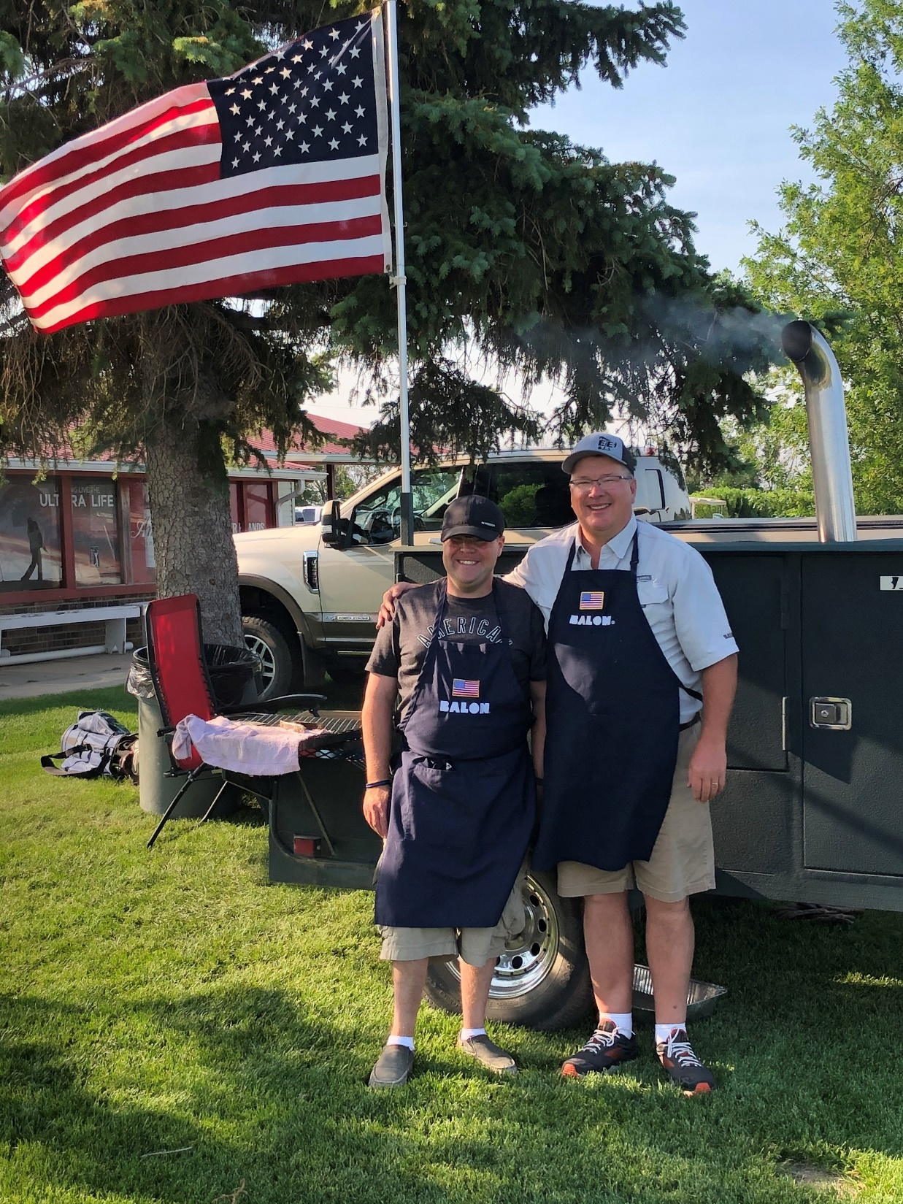
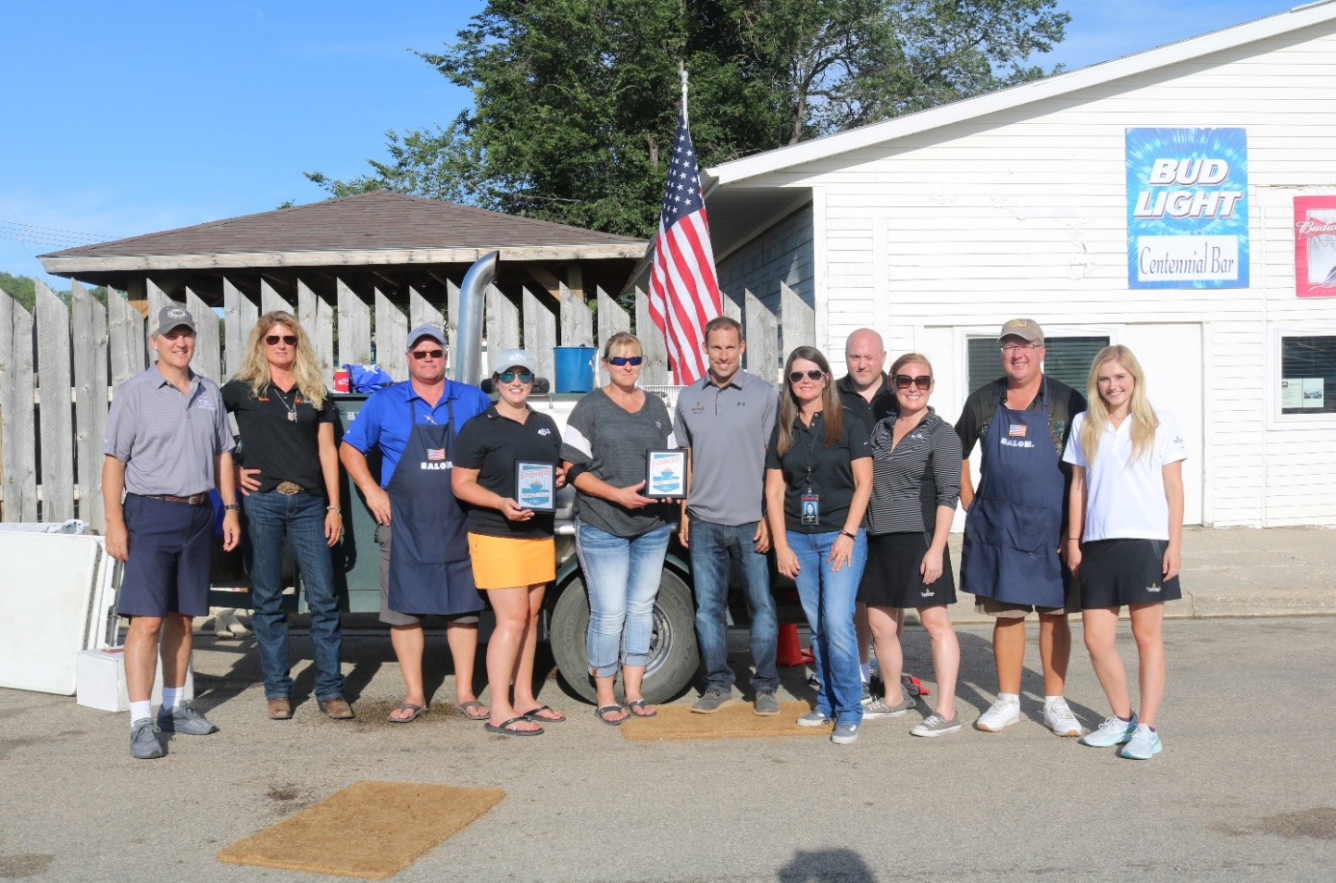

Slide 12
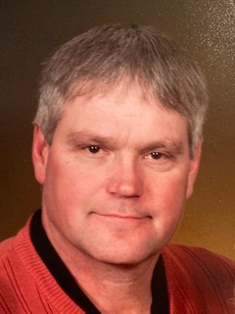
Distinguished
INDUSTRY LEADERS
Brian Rosendahl
SALES REPRESENTATIVE, BALON VALVES

Slide 13
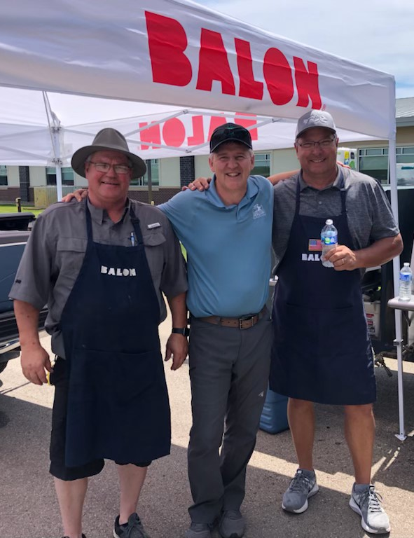
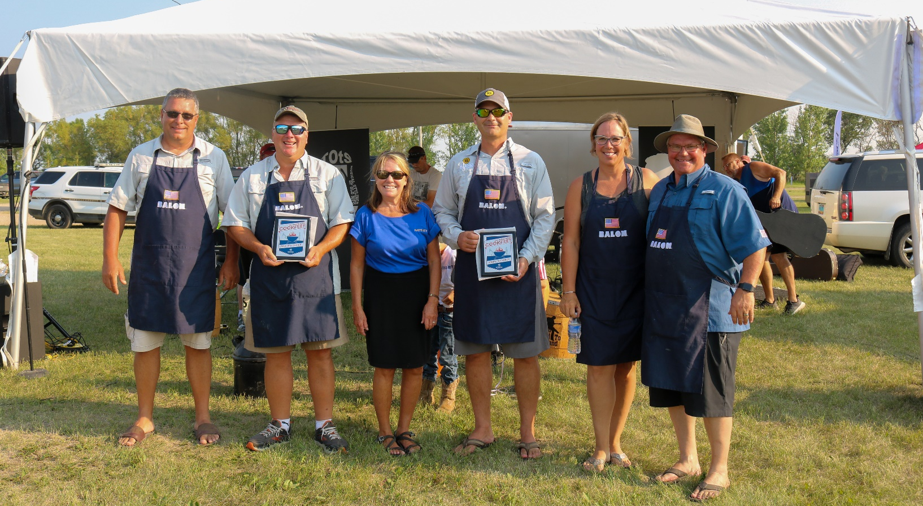
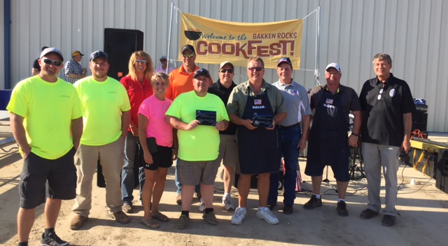

Slide 14
NORTH DAKOTA PETROLEUM COUNCIL
Hall of Fame

Slide 15
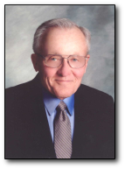
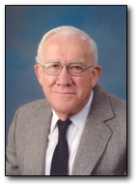
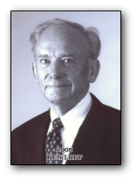
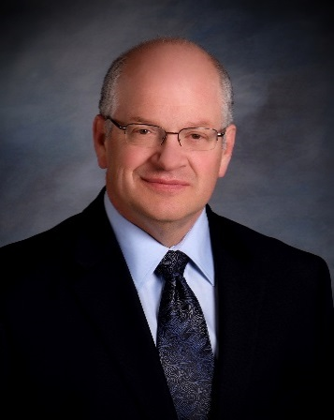
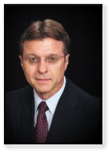
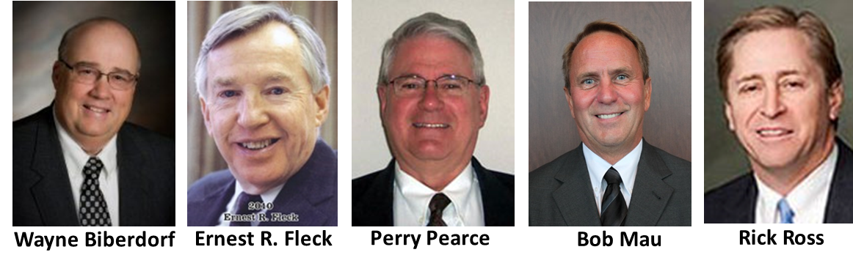
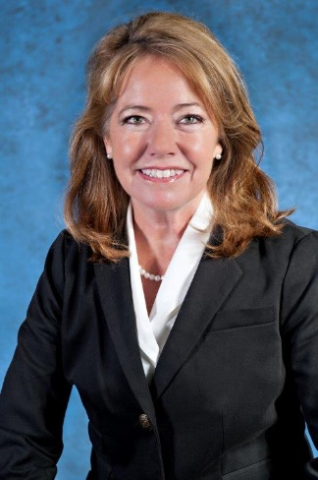
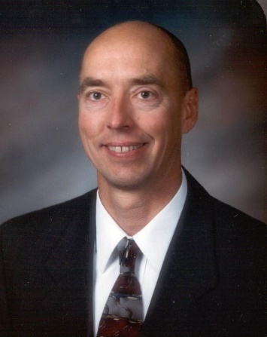
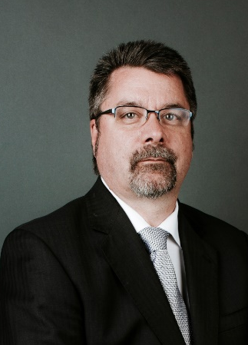
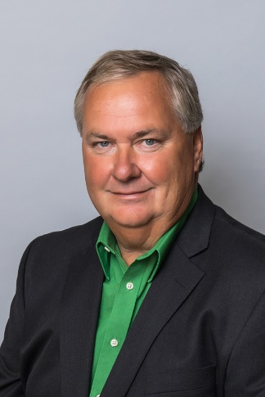
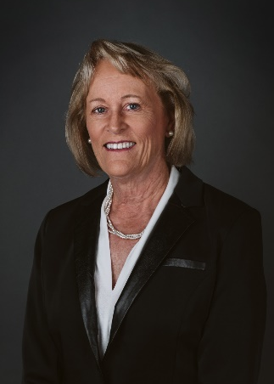
Past Inductees
A.G. Golden
Dick Broschat
Ken Luff
John Morrison
Jeff Herman
Jack Swenson
Wayne Biberdorf
Kathleen Neset
Al Anderson
Craig Smith
Terry Kovacevich
Lynn Moser

Slide 16
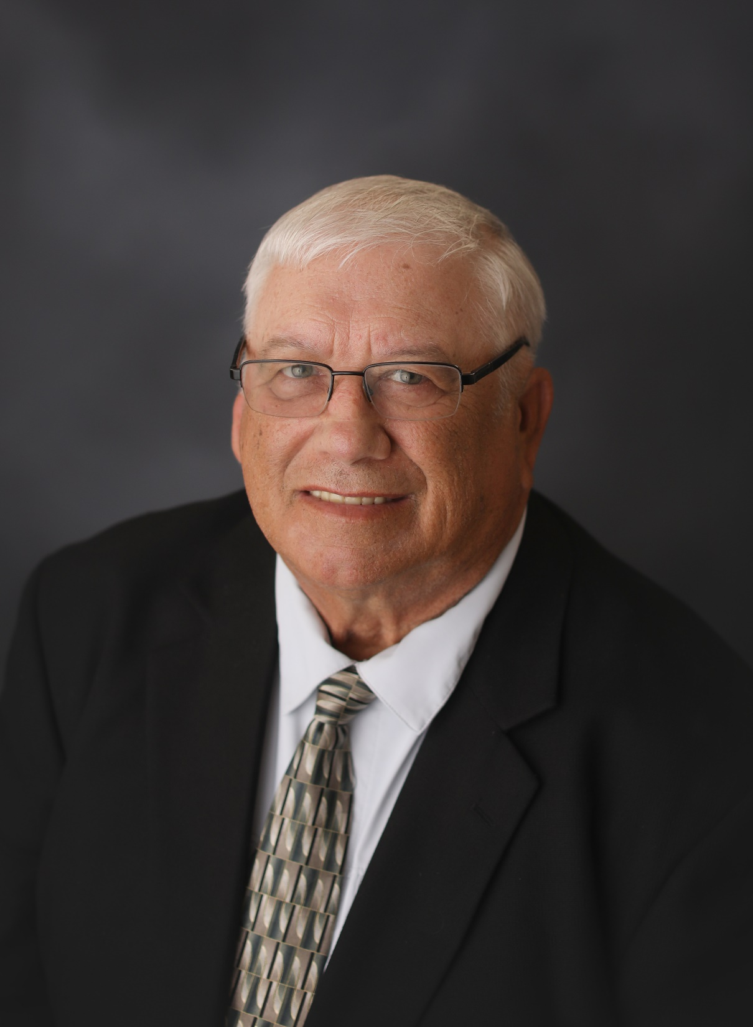
Larry Dokken
2021
Hall Of Fame
INDUCTEE

Slide 17
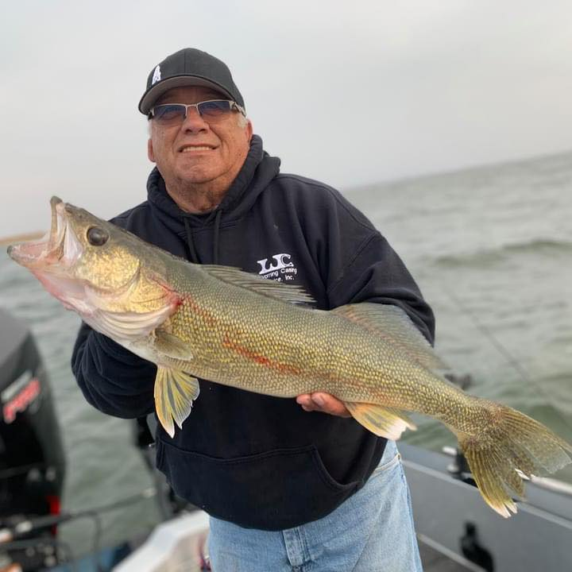
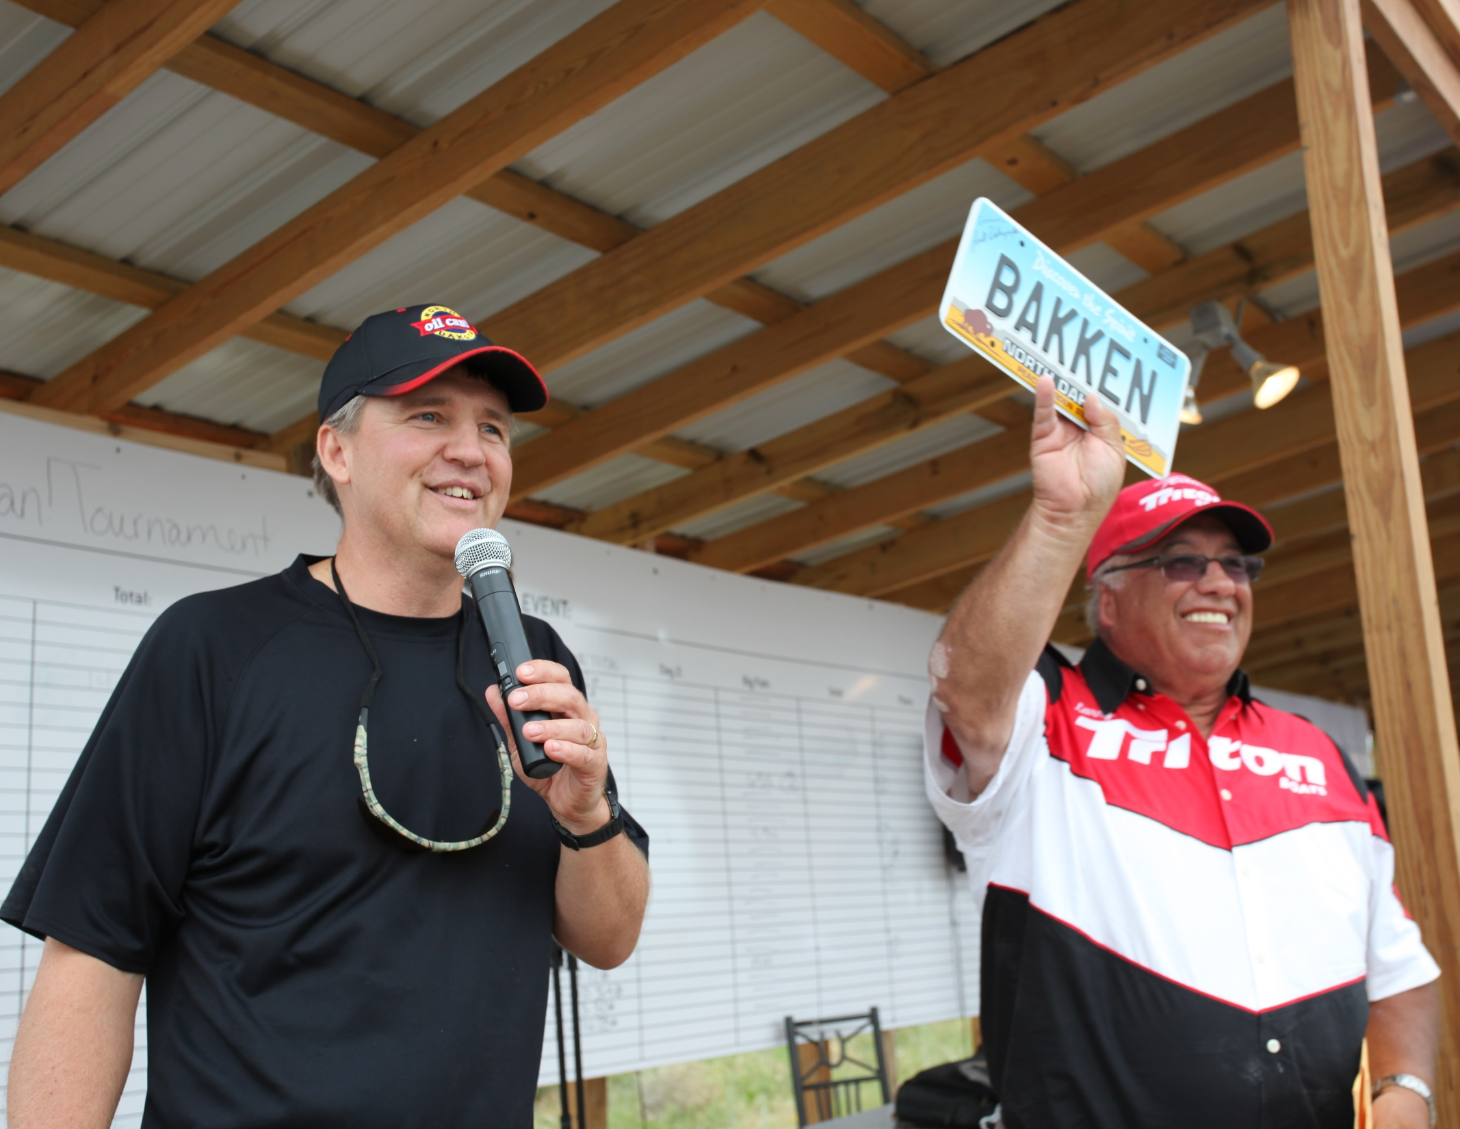
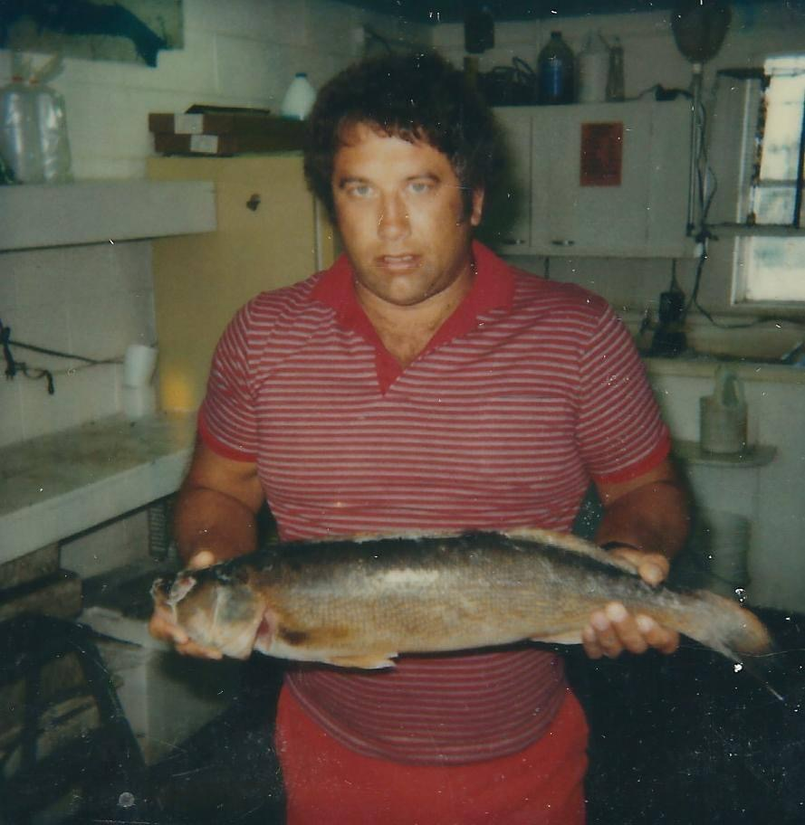

Slide 18
